Slide 1

Welcome
Md. Sabur Khan
Chairman
Board of Trustees
Daffodil International University

Slide 2
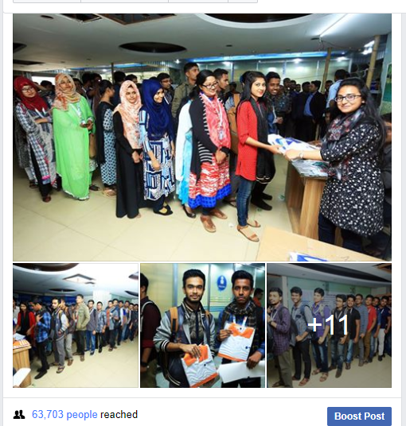
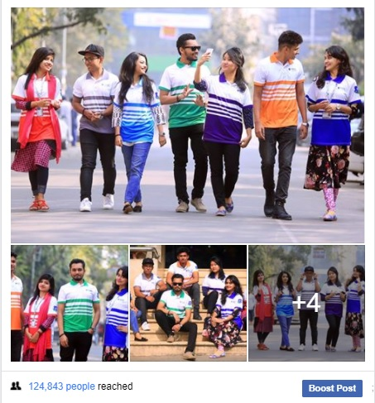
Turned to positive from negative
Be Positive Always
Lots of Negative Comments

Slide 3
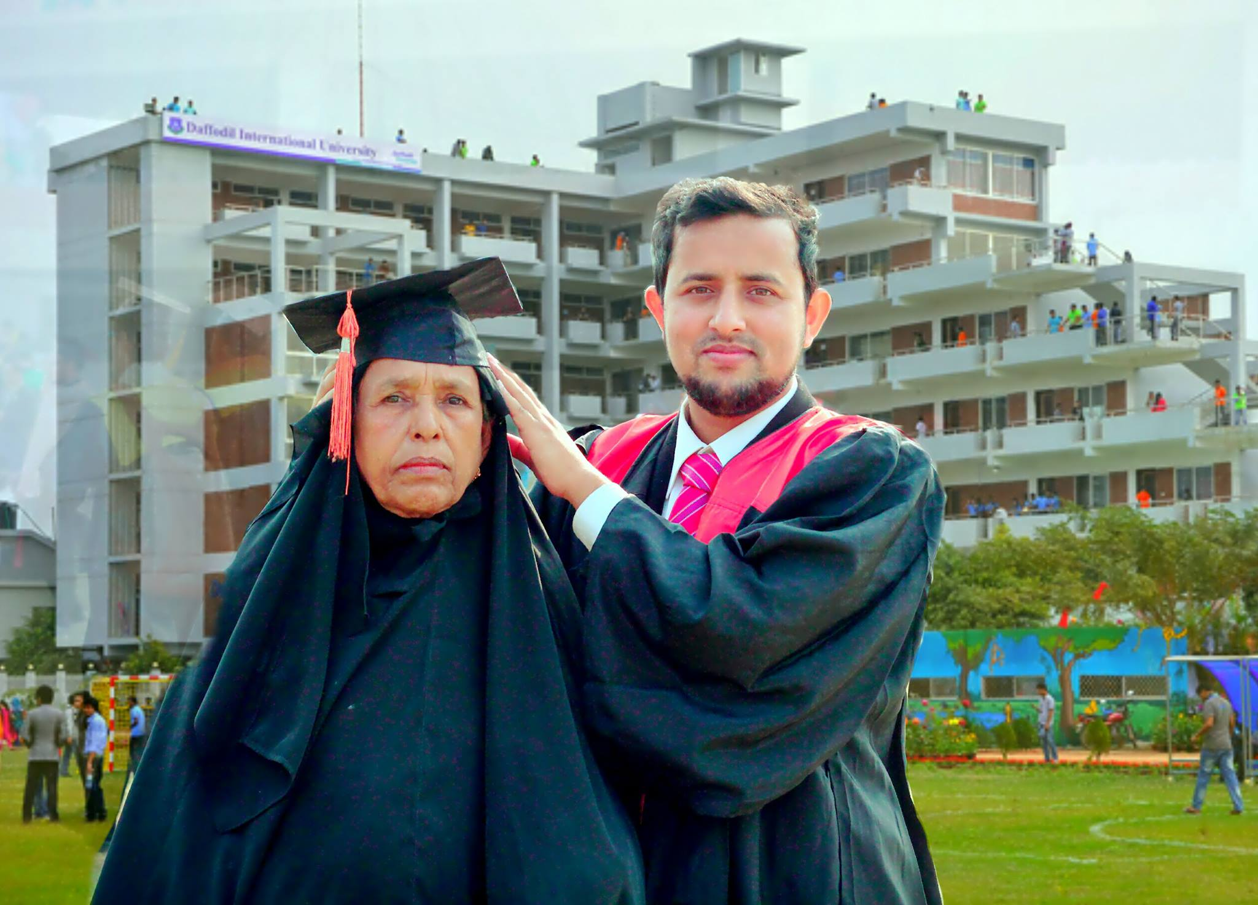
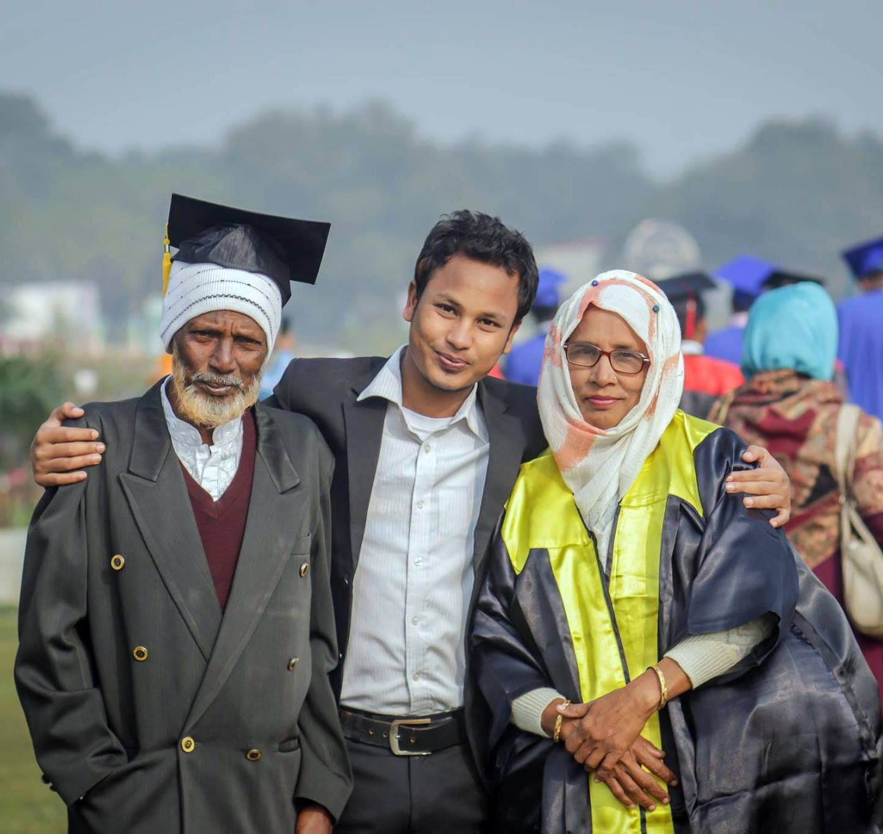
Value Your Parents & Family

Slide 4

Be a good Citizen

Slide 5
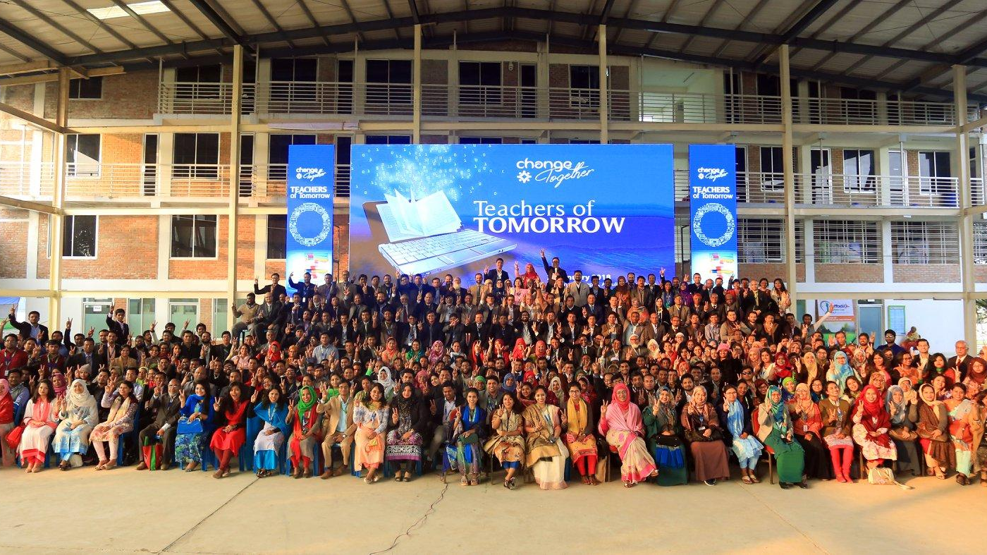
Technology Friendly
&
interactive Education System

Slide 6
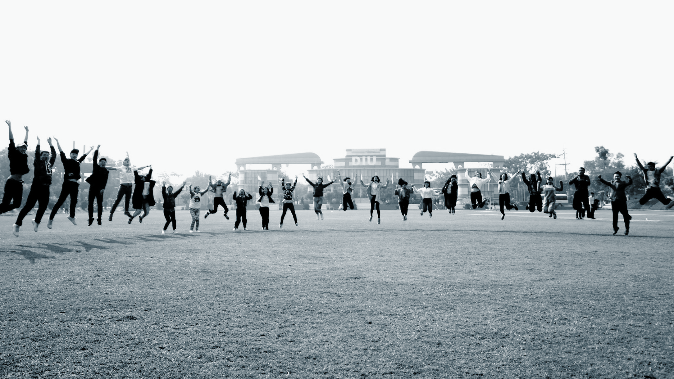
Summer/Winter Camp

Slide 7


Slide 8
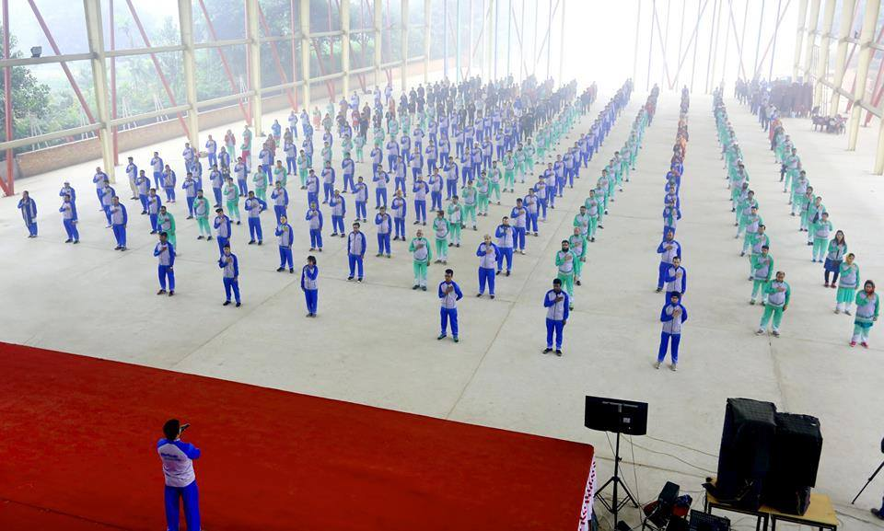
Change Together

Slide 9


Slide 10

Multitasking

Slide 11

Uniqueness

Slide 12
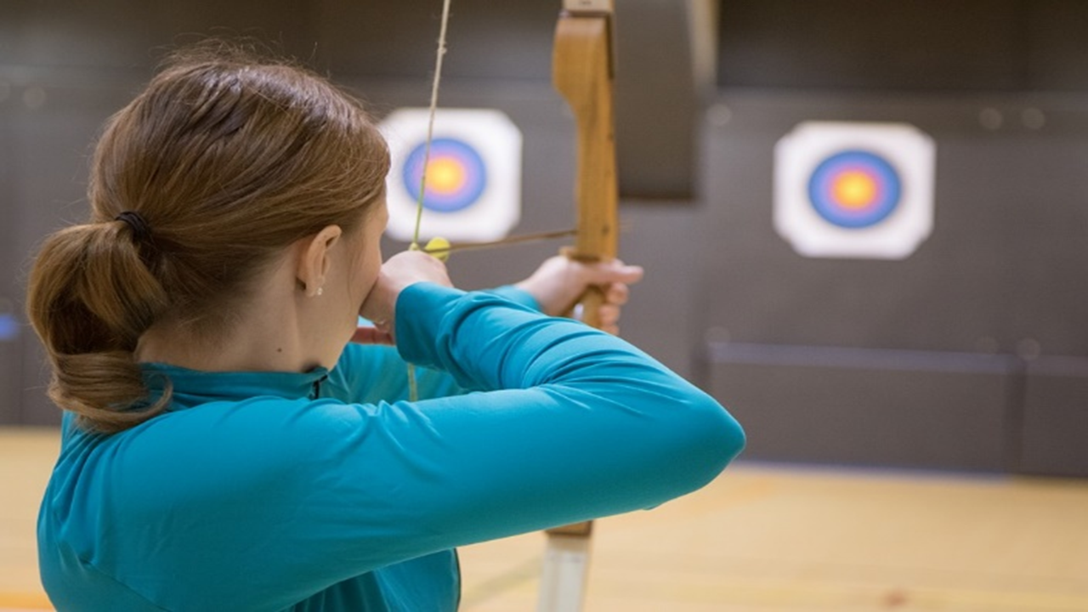
Set Goal
&
Prepare Yourself

Slide 13

SKY IS THE LIMIT

Slide 14





Slide 15

PROBLEM
SOLUTION

Slide 16

INNOVATIVE
IDEA
CREATIVE

Slide 17

SOCIAL MEDIA CHARACTER CERTIFICATE

Slide 18

WORLD IS IN YOUR HAND

Slide 19

Stay True to Yourself
No Matter Where the World Is

Slide 20
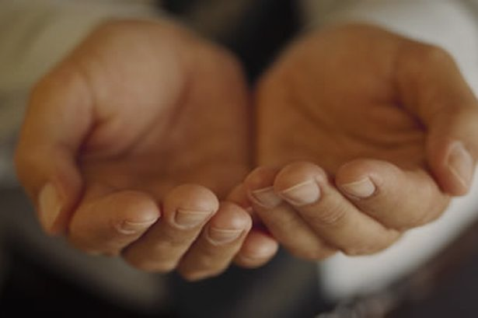
Give Your Learning back to the society
Give Back

Slide 21

Modern Technology Adaptation

Slide 22

Think Different from Others

Slide 23

Earn confidence and trust of Others
by your positive works

Slide 24
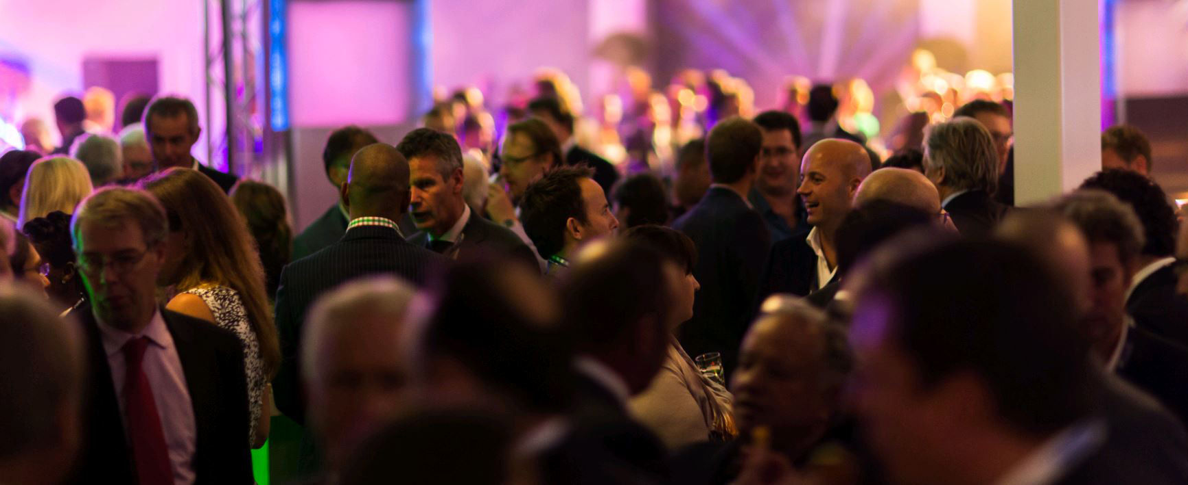
Relationship and Networking

Slide 25

FAITH IN ALMIGHTY

Slide 26

FAITH IN ALMIGHTY

